Slide 1
COMP 2230
Week 4 - Friday

Slide 2
Last time
Examples of SoLHRRwCC's
General recursive definitions

Slide 3
Questions?

Slide 4
Assignment 2

Slide 5
Review

Slide 6
Growth of Functions

Slide 7
Growth of functions
Power functions:
  $p_{a}(x) = x^{a}$ where $a,x≥0$
Increasing and decreasing functions
Let $f$ and $g$ be real-valued functions defined on the same set of nonnegative real numbers
  $f$ is of order at least $g$, written $f(x)$ is $Ω(g(x))$, iff there is a positive $A∈ℝ$and a nonnegative $a∈ℝ$ such that
    $A\left|g\left(x\right)\right|≤|f(x)|$ for all $x > a$
  f is of order at most g, written $f(x)$ is $O(g(x))$, iff there is a positive $B∈ℝ$ and a nonnegative $b∈ℝ$ such that
    $\left|f\left(x\right)\right|≤B|g(x)|$for all $x > b$
  f is of order g, written $f(x)$ is $Θ(g(x))$, iff there are positive $A, B∈ℝ$ and a nonnegative $k∈ℝ$ such that
    $A\left|g\left(x\right)\right|≤\left|f\left(x\right)\right|≤B|g(x)|$ for all $x > k$

Slide 8
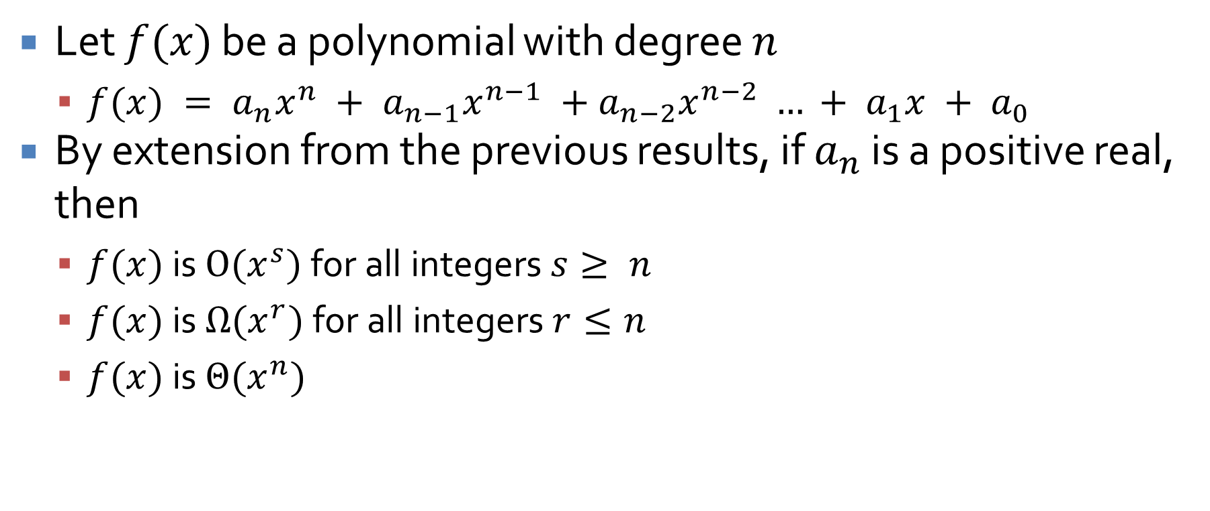
Polynomials
Let $f(x)$ be a polynomial with degree $n$
  $f(x) = a_{n}x^{n} + a_{n−1}x^{n−1} +a_{n−2}x^{n−2} … + a_{1}x + a_{0}$
By extension from the previous results, if $a_{n}$ is a positive real, then
  $f(x)$ is $O(x^{s})$ for all integers $s≥ n$
  $f(x)$ is $Ω(x^{r})$ for all integers $r≤n$
  $f(x)$ is $Θ(x^{n})$

Slide 9
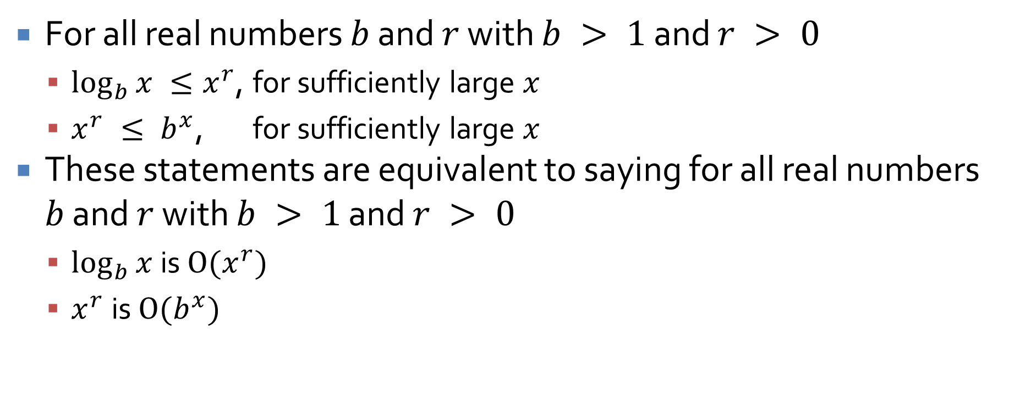
Exponential and logarithmic orders
For all real numbers $b$ and $r$ with $b > 1$ and $r > 0$
  $\log_{b}{x} ≤x^{r}$, for sufficiently large $x$
  $x^{r} ≤ b^{x}$, for sufficiently large $x$
These statements are equivalent to saying for all real numbers $b$ and $r$ with $b > 1$ and $r > 0$
  $\log_{b}{x}$ is $O(x^{r})$
  $x^{r}$is $O(b^{x})$

Slide 10
Running time for algorithms
First, assume that the number of operations performed by $A$ on input size $n$ is dependent only on $n$, not the values of the data
  If $f(n)$ is $Θ(g(n))$, we say that $A$ is $Θ(g(n))$ or that $A$ is of order $g(n)$
If the number of operations depends not only on $n$ but also on the values of the data
  Let $b(n)$ be the minimum number of operations where $b(n)$ is $Θ(g(n))$, then we say that in the best case, $A$ is $Θ(g(n))$ or that $A$ has a best case order of $g(n)$
  Let $w(n)$ be the maximum number of operations where $w(n)$ is $Θ(g(n))$, then we say that in the worst case, $A$is $Θ(g(n))$ or that A has a worst case order of $g(n)$

Slide 11
Computing running time
With a single for (or other) loop, we simply count the number of operations that must be performed
When loops do not depend on each other, we can simply multiply their iterations (and asymptotic bounds)
When loops depend on each other, we should analyze the loops like a series
Repeated divisions by a constant $k$ often lead to a $\log_{k}{n}$ term

Slide 12
Far too easy
What's the Big Theta bound if $n$ is the length of values?
public static double average(int[] values) {
double sum = 0.0;
for(int i = 0; i < values.length; ++i) {
sum += values[i];
}
return sum / values.length;
}

Slide 13
A little tougher
What's the Big Theta bound if $n$ is the length of people?
public static void meeting(Person[] people) {
for(int i = 0; i < people.length; ++i) {
for(int j = i + 1; j < people.length; ++j) {
people[i].shakeHands(people[j]);
}
}
}

Slide 14
Watch your step
What's the Big Theta bound if $n$ is n?
public static void powers(int n) {
int i = 1;
while(i <= n) {
System.out.print(i);
i *= 2;
}
}

Slide 15
Keep watching your step
What's the Big Theta bound if $n$ is n?
for(int i = 1; i < n; ++i) {
for(int j = 0; j < n; j += i) {
System.out.println("*");
}
}

Slide 16
Steps on steps
What's the Big Theta bound if $n$ is n?
for(int i = 1; i < n; i *= 2) {
for(int j = 1; j < n; j *= 3) {
System.out.println("#");
}
}

Slide 17
Steps on steps on steps
What's the Big Theta bound if $n$ is n?
int counter = 1;
for(int i = 1; i <= n; ++i) {
for(int j = 0; j < counter; ++j) {
System.out.println("$");
}
counter *= 2;
}

Slide 18
Switch it up
What's the Big Theta bound if $n$ is n?
int counter = 1;
for(int i = 1; i <= n; ++i) {
for(int j = 0; j < n/counter; ++j) {
System.out.println("$");
}
counter *= 2;
}

Slide 19
Back to your roots
What's the Big Theta bound if $n$ is n?
for(int i = 0; i*i < n; ++i) {
for(int j = 0; j < n; ++j) {
System.out.println("%");
}
}

Slide 20
Sequences and Induction

Slide 21
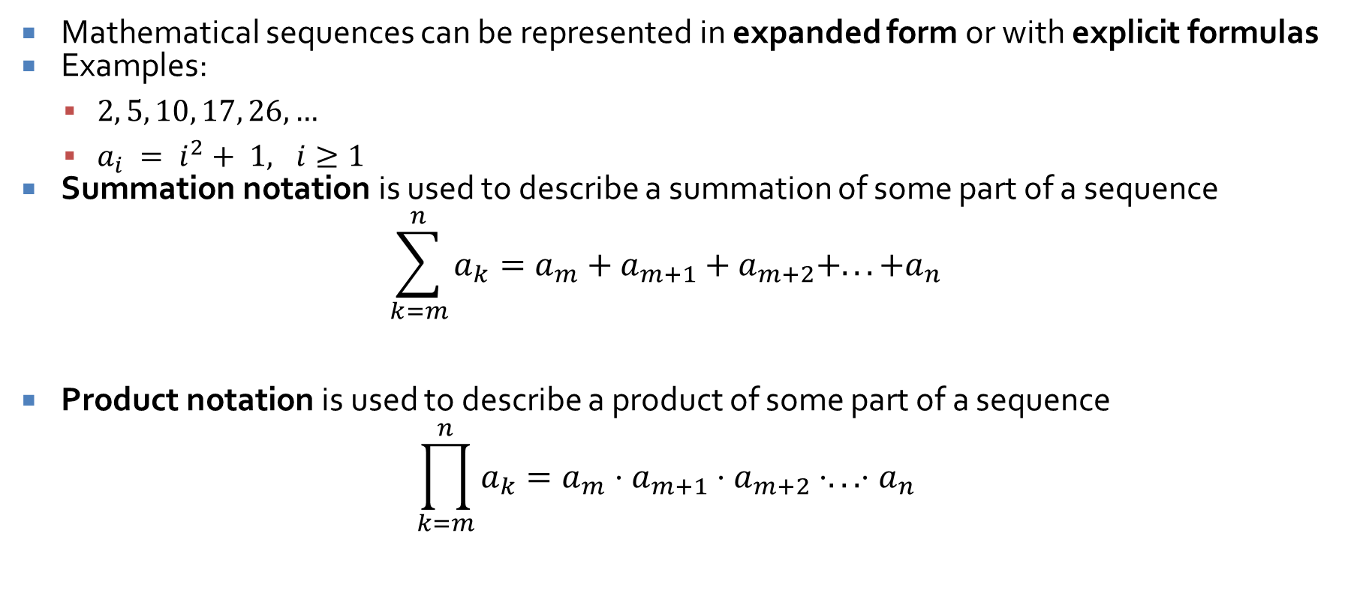
Sequences
Mathematical sequences can be represented in expanded form or with explicit formulas
Examples:
  $2, 5, 10, 17, 26, …$
  $a_{i} = i^{2}+ 1, i≥1$
Summation notation is used to describe a summation of some part of a sequence
$$\sum_{k=m}^{n}{a_{k}}=a_{m}+a_{m+1}+a_{m+2}+...+a_{n}$$
Product notation is used to describe a product of some part of a sequence
$$\prod_{k=m}^{n}{a_{k}}=a_{m}⋅a_{m+1}⋅a_{m+2}⋅...⋅a_{n}$$

Slide 22
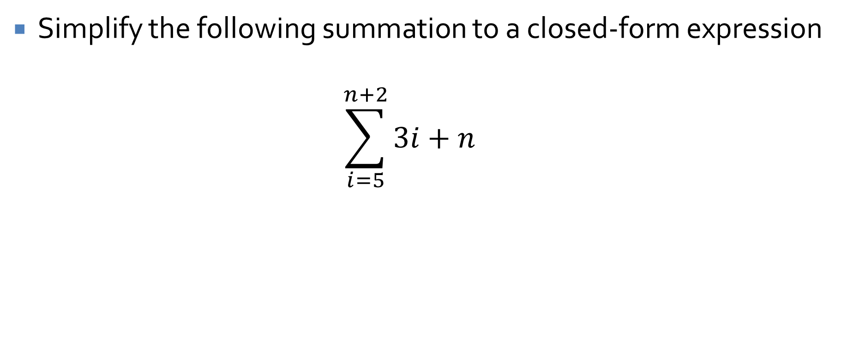
Simplify
Simplify the following summation to a closed-form expression
$$\sum_{i=5}^{n+2}{3i+n}$$

Slide 23
Proof by mathematical induction
To prove a statement of the following form:
  $n  ℤ$, where $n  a$, property $P(n)$ is true
Use the following steps:
  Basis Step: Show that the property is true for $P(a)$
  Induction Step:
    Suppose that the property is true for some $n = k$, where $k  ℤ, k  a$
    Now, show that, with that assumption, the property is also true for $k + 1$

Slide 24
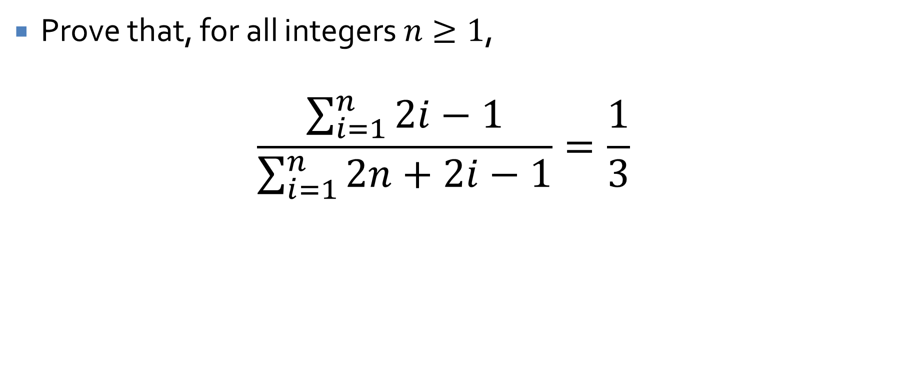
Mathematical induction example
Prove that, for all integers $n≥1$,
$$\frac{\sum_{i=1}^{n}{2i−1}}{\sum_{i=1}^{n}{2n+2i−1}}=\frac{1}{3}$$

Slide 25
Recursion
Using recursive definitions to generate sequences
Writing a recursive definition based on a sequence
Using mathematical induction to show that a recursive definition and an explicit definition are equivalent

Slide 26
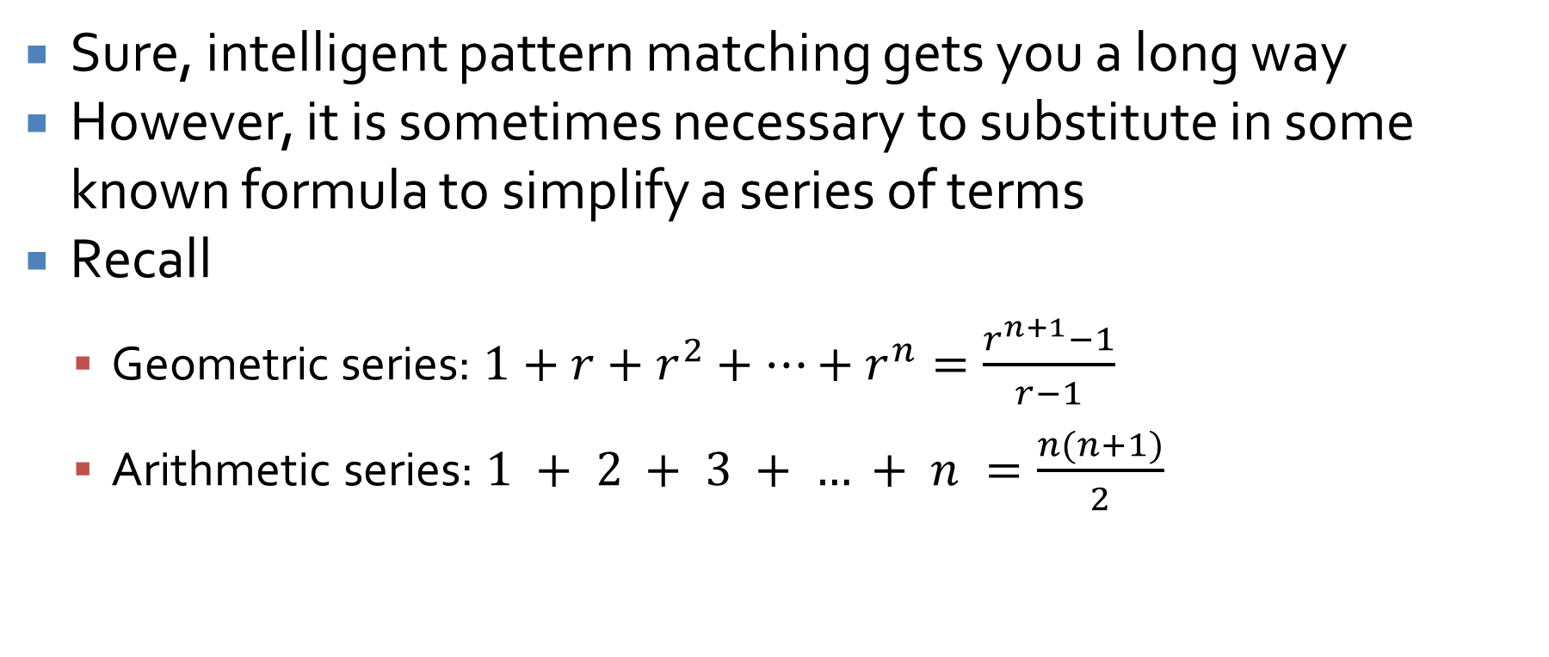
Employing outside formulas
Sure, intelligent pattern matching gets you a long way
However, it is sometimes necessary to substitute in some known formula to simplify a series of terms
Recall
  Geometric series: $1+r+r^{2}+…+r^{n}=\frac{r^{n+1}−1}{r−1}$
  Arithmetic series: $1 + 2 + 3 + … + n =\frac{n(n+1)}{2}$

Slide 27
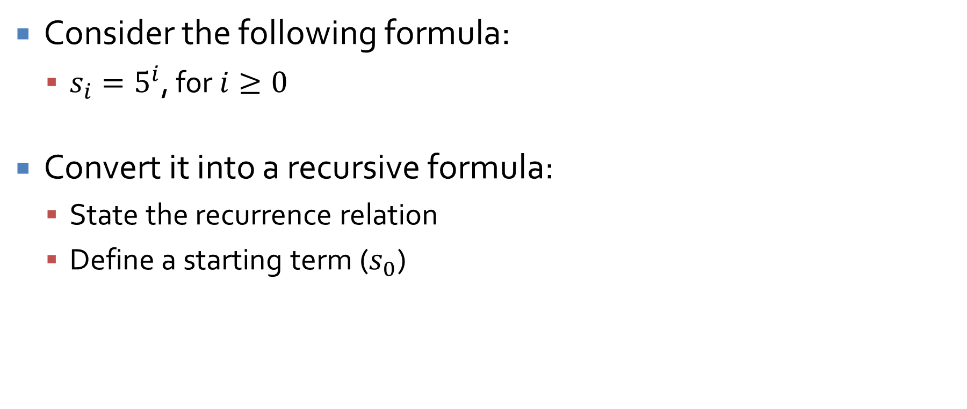
Changing from iteration to recursion
Consider the following formula:
  $s_{i}=5^{i}$, for $i≥0$
Convert it into a recursive formula:
  State the recurrence relation
  Define a starting term ($s_{0}$)

Slide 28
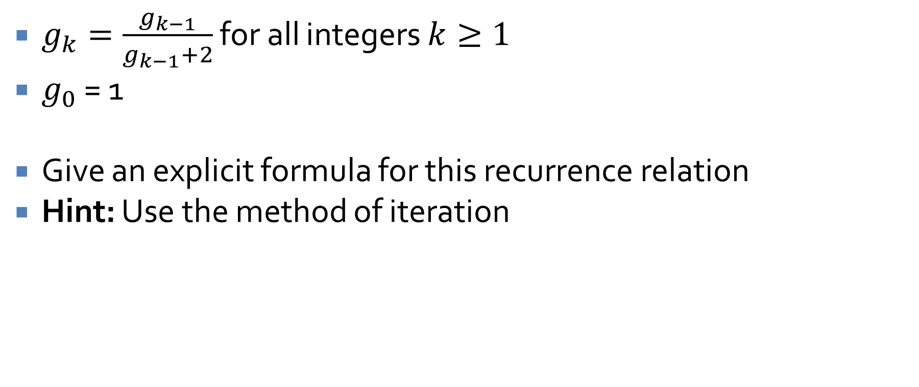
Recursive sequence example
$g_{k}=\frac{g_{k−1}}{g_{k−1}+2}$ for all integers $k≥1$
$g_{0}$ = 1
Give an explicit formula for this recurrence relation
Hint: Use the method of iteration

Slide 29
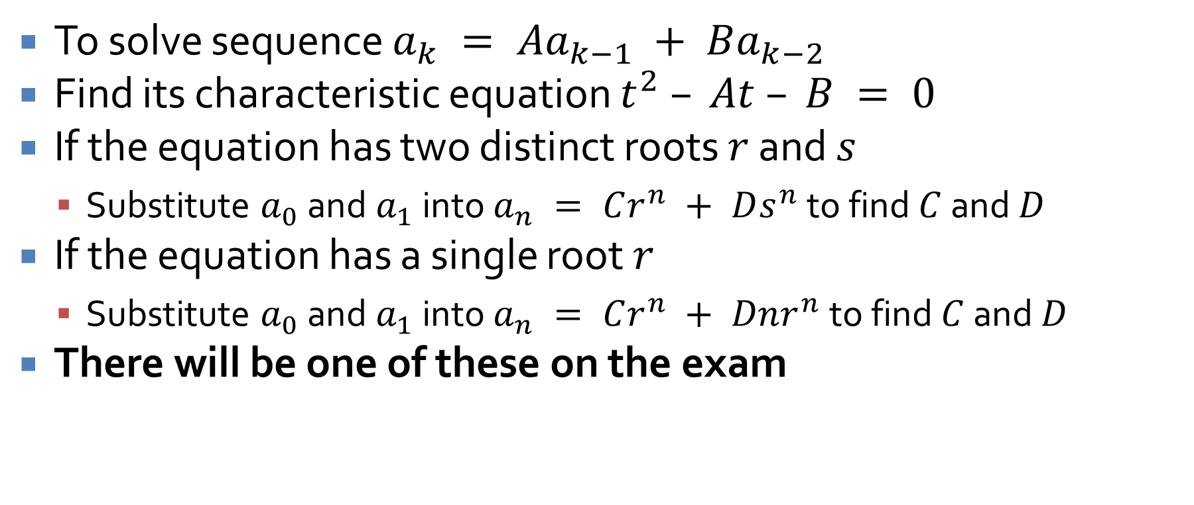
Solving second order linear homogeneous recurrence relations with constant coefficients
To solve sequence $a_{k} = Aa_{k−1} + Ba_{k−2}$
Find its characteristic equation $t^{2} – At – B = 0$
If the equation has two distinct roots $r$ and $s$
  Substitute $a_{0}$ and $a_{1}$ into $a_{n} = Cr^{n} + Ds^{n}$ to find $C$ and $D$
If the equation has a single root $r$
  Substitute $a_{0}$ and $a_{1}$ into $a_{n} = Cr^{n} + Dnr^{n}$ to find $C$ and $D$
There will be one of these on the exam

Slide 30
Ticket Out the Door

Slide 31
Upcoming

Slide 32
Next time…
Exam 1!

Slide 33
Reminders
Finish Assignment 2
  Due tonight by midnight!
Study for Exam 1
  Next Monday!

